Slide 1
Short Story Presentation
Samarth Shyamsundar Sharma

Slide 2
AGENDA
Introduction​ of the Problem
Primary goal (Objective)
​Proposed Approach
Methodology
Example
Experimentation
Analysis
​Conclusion​

Slide 3
Introduction
Research Paper: Link to the Research Paper titled Enhanced Approach for Agglomerative Clustering
Using Topological Relations
Despite the significant advancement and maturity in the field of spatial clustering, current methods predominantly rely on user-defined parameters and commonly use the distance between objects as a measure of similarity. Consequently, these techniques often face challenges in terms of performance and scalability.

Slide 4
PRIMARY GOAL
To Increase the Scalability of the Clustering Algorithm by somehow reducing the calculation but not at the cost of performance

Slide 5
Proposed Approach to Go About Spatial Clustering: ACUTE
ACUTE stands for Agglomerative Clustering Using Topological Relations Effectively.
This approach evaluates spatial objects by examining the topological relationships of their spatial points, ensuring both closeness within clusters and distinctness between different clusters.
Unlike traditional clustering techniques that rely on comparing distances between objects pairwise, ACUTE concentrates on utilizing topological relations.
This strategy decreases the total distance calculations needed, thereby reducing the number of comparisons necessary. As a result, ACUTE improves efficiency and enhances scalability.

Slide 6
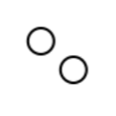
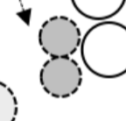
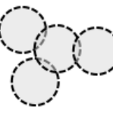
Topological Relations
Disjoint
Meet
Overlap
a disjoint relation between A and B spatial points exists if one point’s parts intersect at most with the other point’s exterior
a meet relation between A and B spatial points exists if there is no intersection between both interiors, but the boundary/ interior of one point intersects by the boundary of the other point.
an overlapping relationship between A and B spatial points exists if there is an intersection between one point’s interior and the other point’s exterior and interior regions

Slide 7
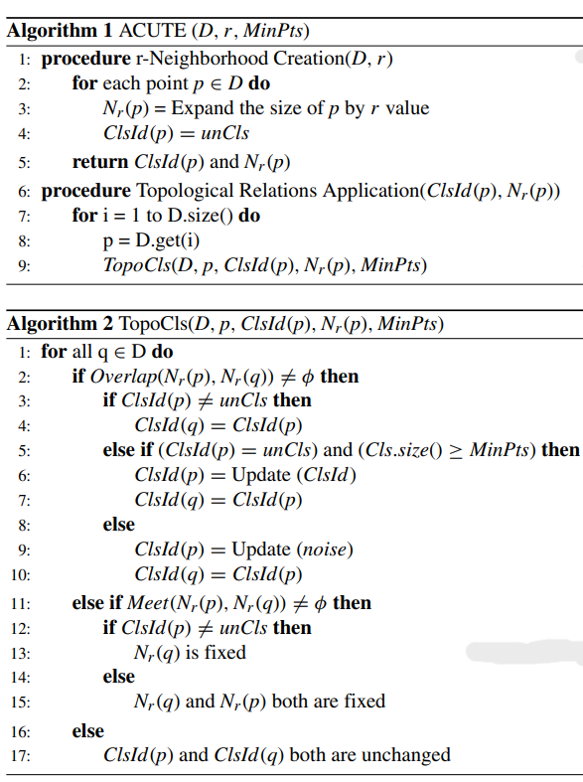
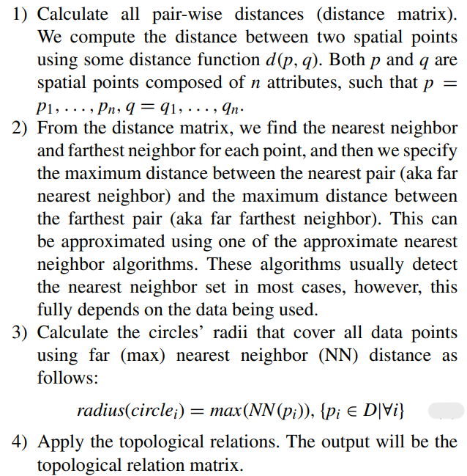
Methodology

Slide 8
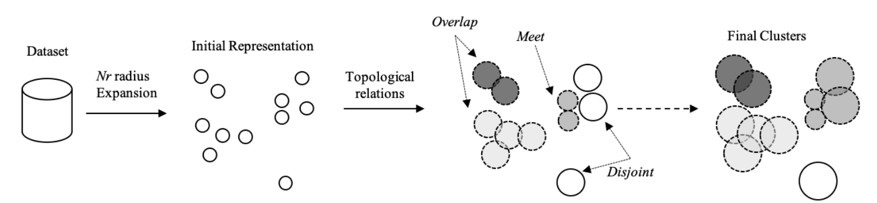
Frame Work
Dataset consists of all the data points or entries.
Expanding the Radius
Checking out the topological relations(Overlap, Meet and Disjoint)
At the end of the process, highlighting the clusters.

Slide 9
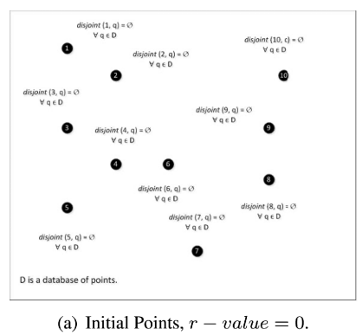
Example
We have 10 points/entries in the dataset.
Initially all the points are disjoint, with a radius value of 0.
All the points are assigned the cluster ID as unclassified at the beginning.

Slide 10
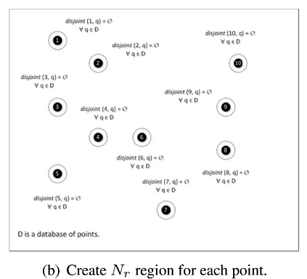
Adding Radius to all the entries that are disjoint topologically (As this is the beginning all the points are disjoint)
Even after adding the radius region all the topological relations are still disjoint.

Slide 11
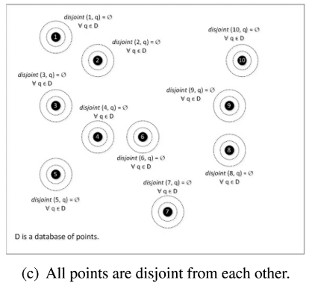
Adding Radius to all the entries that are disjoint topologically.
Still all the points are topologically disjoint.
Note: We can keep on increasing the radius for n times (where n is the number of data points left in the dataset that are unclassified)
So, as we have 10 points, we can go on increasing the radius 8 more times(as it has already been done 2 times now).

Slide 12
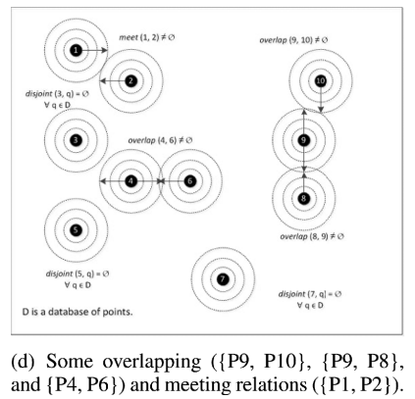
Adding Radius to all the entries that are disjoint topologically.
P1’s and P2’s topological relation has been updated to meet. Thus, now their radii will be fixed and won’t increase anymore.
Similarly, P4 and P6 overlap, P8 and P9 overlap, and P9 and P10 overlap.
Thus, only P3, P5 and P7 remain disjoint and unclassified.
Note: As there are three points left in the dataset that are disjoint and unclassified, the radius can be enlarged only three times at most.

Slide 13
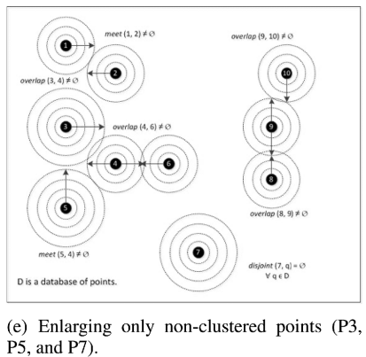
Adding Radius to all the entries that are disjoint topologically. (Only P3, P5, and P7 this time)
P3 and P4 overlap, p4 and P5 meet.
Only P7 is now disjoint and unclassified.
Note: As there is only one point left in the dataset that is disjoint and unclassified, the radius can be enlarged only one last time.

Slide 14
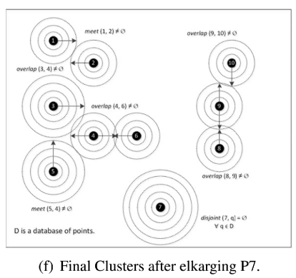
Adding Radius to all the entries that are disjoint topologically. (Only P7)
The clustering process has ended.
P7 is still disjoint and thus is declared as an outlier. On the other hand, all the other points have become part of a cluster.

Slide 15
Simply put, at the end of the clustering process, if a data point belongs to a group of points aggregated based on topological properties ‘meet’ and ‘overlap’ which has the total number of points greater than minpts (Minimum number of points to consider a group of points as a cluster) then they belong to a cluster, on the other hand if a data point remains in a group with count of data points less than minpts it is classified as an outlier.
Advantages of this approach for clustering:
agglomerates spatial points in all directions of the topological space.
the need to know in advance the final number of clusters is eliminated.
minimization of the total number of comparisons to compute similarity.

Slide 16
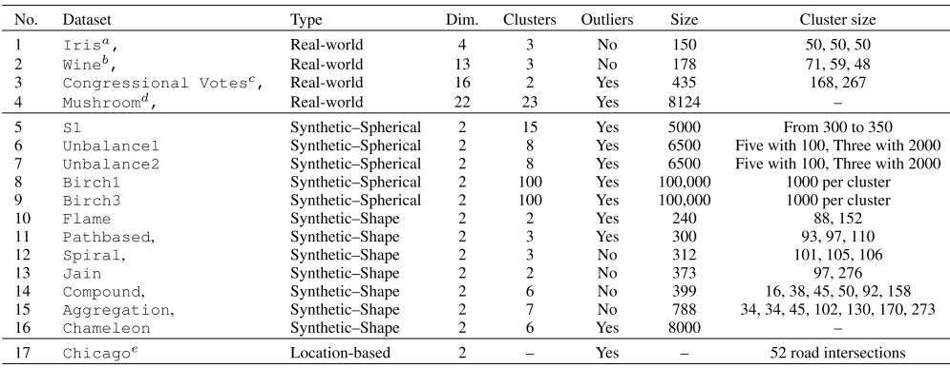
Validating ACUTE on Real World and Synthetic Datasets
There are 5 Real World Datasets and 12 Synthetic Datasets for experimentation.

Slide 17
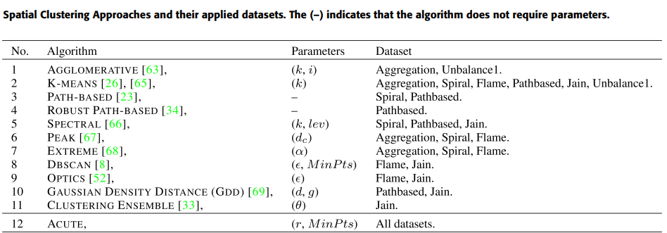
Details of which algorithm was applied to which dataset during the experimentation phase.

Slide 18
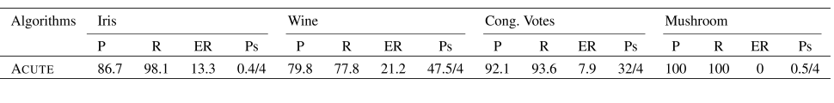
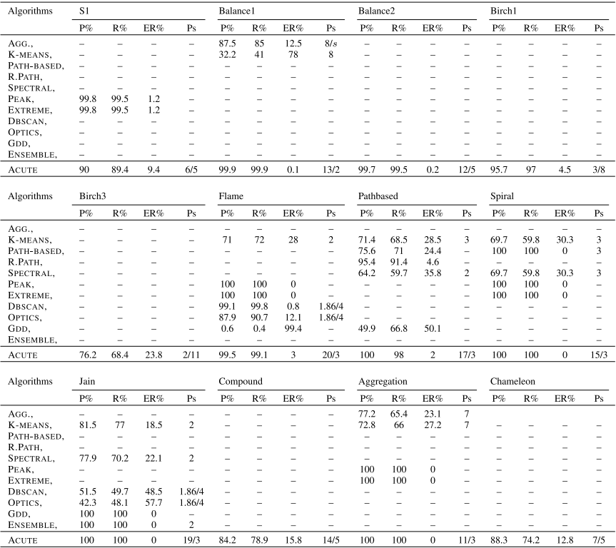
Results

Slide 19
Accuracy and Efficiency Analysis:
ACUTE showed optimal values for several datasets like Balance1, Flame, Path-based, Spiral, Jain, and Aggregation, often outperforming other algorithms like Agglomerative, K-Means, DBSCAN, OPTICS, Path-Based, Robust Path-Based, Spectral, and GDD.
For specific datasets like S1 and Flame, PEAK and EXTREME algorithms had the best accuracy, while for Spiral, Jain, and Aggregation, ACUTE shared the top spot with these algorithms.
In datasets with varied densities and shapes, such as Unbalance1, ACUTE demonstrated its capability to detect all clusters effectively, including outlier points.

Slide 20
Performance Analysis:
The performance of ACUTE was also assessed in terms of clustering time and accuracy. The algorithm’s performance varies with the parameter ‘r-value’, and it was observed that an increase in ‘r-value’ generally reduces computation time and increases accuracy.
ACUTE was tested on large synthetic datasets like Birch1, Birch3, and Chameleon to measure scalability and accuracy. The results indicated that ACUTE is relatively scalable and maintains a good balance between clustering time and accuracy.

Slide 21
Comparative Results:
The study showed that while algorithms like K-Means and Spectral are effective for spherical-shaped clusters, they struggle with irregularly shaped clusters.
DBSCAN and OPTICS were found effective for irregular shapes but not as effective for varied density clusters.
ACUTE was noted for its ability to detect clusters of any shape and effectively identify outliers.

Slide 22
Conclusion
The ACUTE algorithm demonstrates a faster performance compared to other methods, with a time complexity of O(n-1) in the best-case scenario.
It achieves high accuracy, precision, and recall values across most datasets used in the study.
ACUTE requires two user-defined parameters, like most clustering methods, and its effectiveness can vary with the data distribution.

Slide 23
THANK YOU
Samarth Shyamsundar Sharma
samarthshyamsundar.sharma@sjsu.edu

